Slide 1
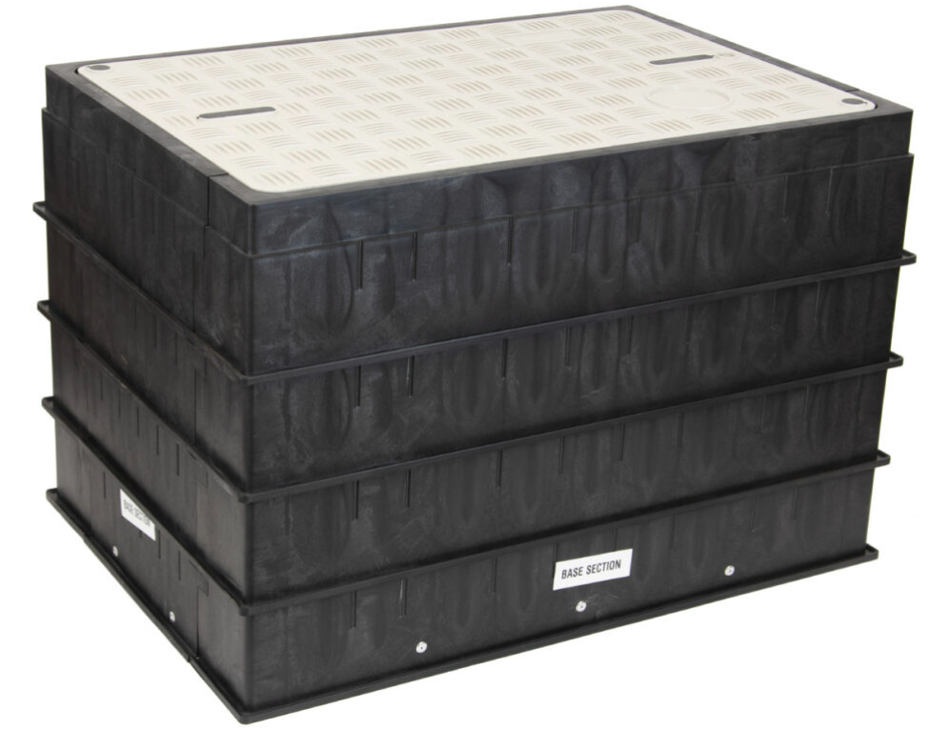
Dura-Line Handholes
1
December 13, 2024

Slide 2
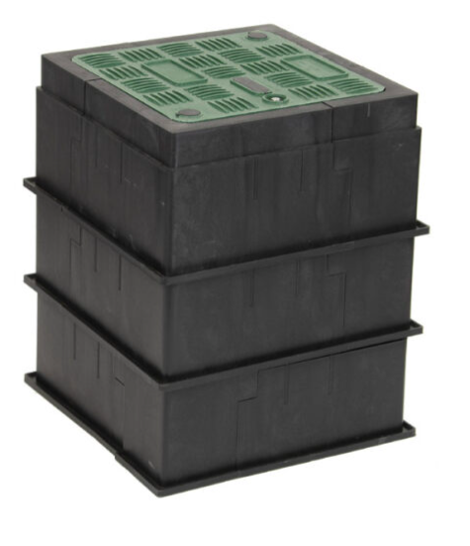
Overview
Dura-Line Handholes
Innovative modular design based on industry professional feedback
Warehouse friendly package requires less space and freight cost
Simple 1-person installation with focus on safety
100% recycled polypropylene chamber body

Slide 3
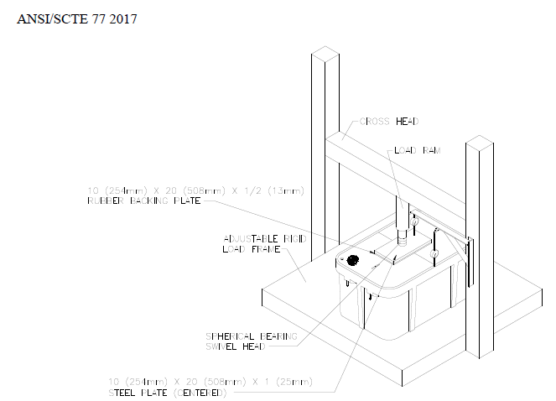
Testing and Certifications
All Dura-Line Handholes meet or exceed
ANSI/SCTE 77 2017 Standards for Testing and Performance
Environmental Test
Chemical Resistance
Simulated Sunlight Exposure
Water Absorption
Flammability
Internal Equipment Protection Test
Structural Load Tests
Lateral Sidewall Load Test
Vertical Sidewall Load Test
Cover Vertical Load Test
Loading Acceptance Criteria
Cover Impact
Torque Value of Fastening Devices
*All testing completed at an independent 3rd Party Facility

Slide 4


Sustainability and Future Planning
All Hand Hole Chambers are manufactured from 100% Recycled Polypropylene
US Manufacturing scheduled to begin Q4 2024
Evaluation of BABA compliance planned for completion prior to the start of US Manufacturing
Packaging designed to maximize shipping capabilities to reduce carbon emissions related to shipment of raw materials and finished goods.

Slide 5
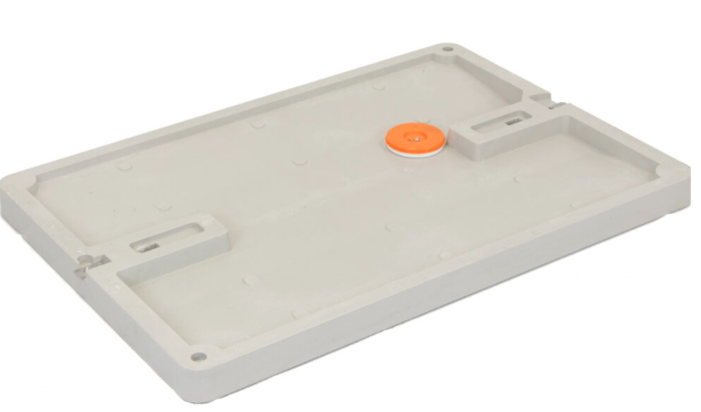
Available Sizes
Includes
12x12
13x18
13x24
17x30
24x36
Larger sizes in future development
*All sizes are available in Tier 8
*All sizes other than 12x12 are available in Tier 22
*Dimensions listed are based on interior measurement allowing for full use of advertised space
Pre-installed locator puck
Quarter Turn locking mechanism on lid
Pre-installed metal clip in lid prevents lid from floating away in case of flooding
(2) Lag bolts for lid additional security (available option of Johnny bolts)
Racks for Tier 22 chambers
Lids are Green for Tier 8 and Grey for Tier 22

Slide 6
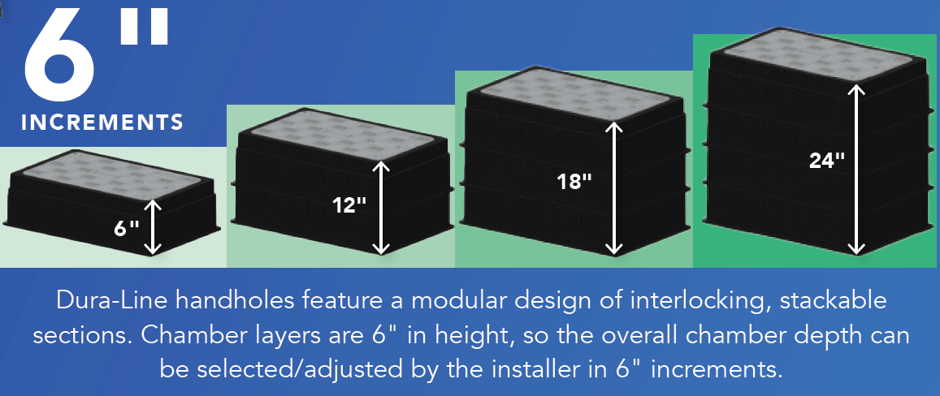
Modular Design

Slide 7
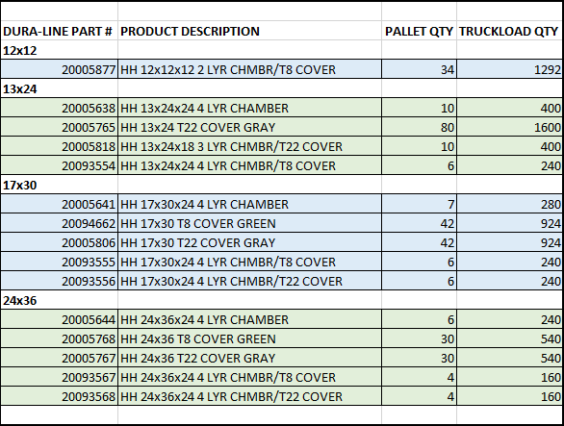
Shipping details
Available pallet configurations:
- Segregated - Lids and chambers come on separate pallets
- Combo – Lids and chambers come on same pallet
*Various load configurations available

Slide 8


